Slide 1
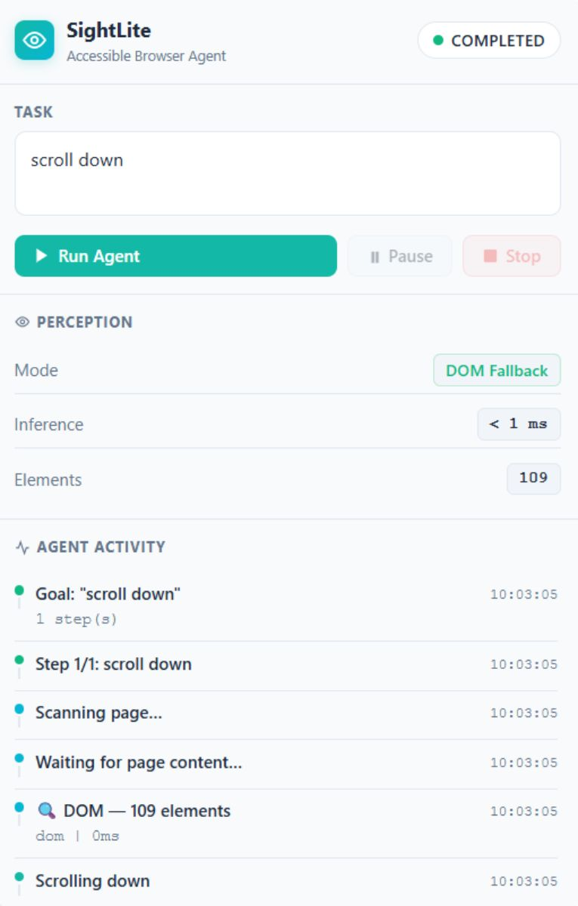
TEAM BLUEBIRD · PRODUCT OVERVIEW
SightLite
An accessible AI-powered Chrome browser agent that sees, acts, and verifies through natural language.
Project members: Keertana · Arpita Sanjay Gavi
MODE
PLATFORM
See · Act · Verify
Chrome extension
SightLite interface

Slide 2




THE PROBLEM
Web interaction is still harder than it should be
DYNAMIC INTERFACES
DOM BLIND SPOTS
Dynamic interfaces make buttons, forms, links, and controls difficult to locate.
DOM-only automation can miss visually rendered elements, while shadow DOM, canvas, and iframes add friction.
ACCESS GAP
SIGHTLITE’S ROLE
For visually impaired users, finding and operating webpage controls can be especially challenging.
SightLite turns a spoken or typed goal into a guided, perceivable browser task.
02

Slide 3
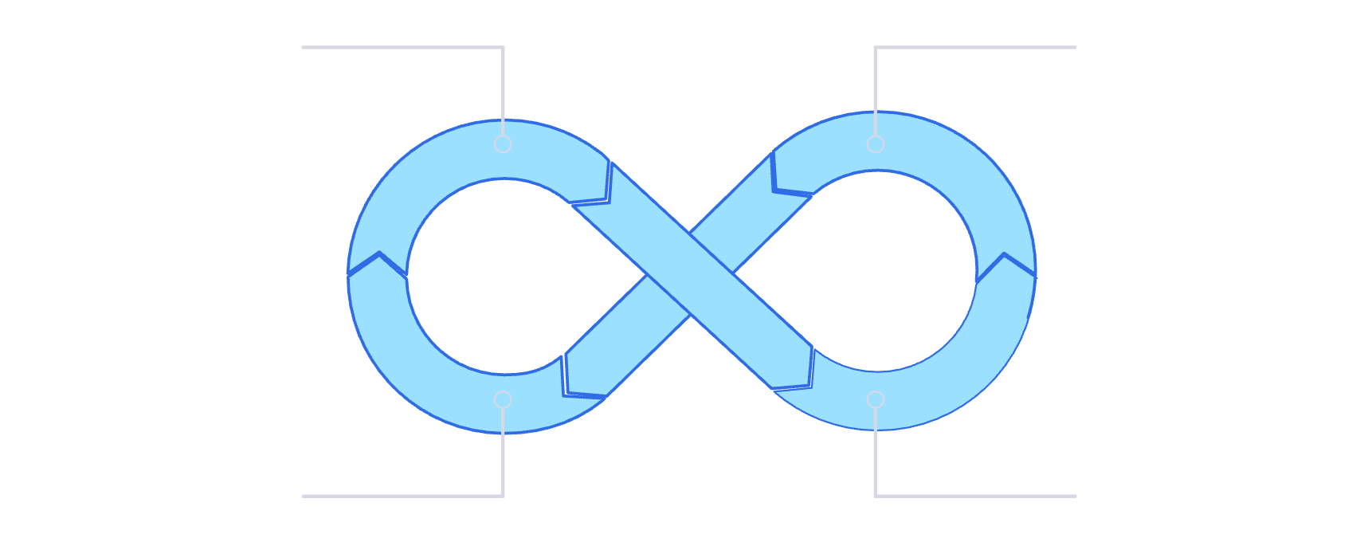

THE AGENT LOOP
One loop turns a goal into a verified action
Understand: interpret the user’s natural-language goal.
Perceive: combine ONNX-based vision with DOM fallback.
Plan: convert the goal into structured actions.
Act: click, type, or scroll with safety checks.
Verify: confirm the page changed as expected, then observe again.
Understand Goal
Observe & Perceive
Act & Verify
Plan & Safety
Core loop: Observe → Perceive → Plan → Safety Check → Act → Verify.
03

Slide 4
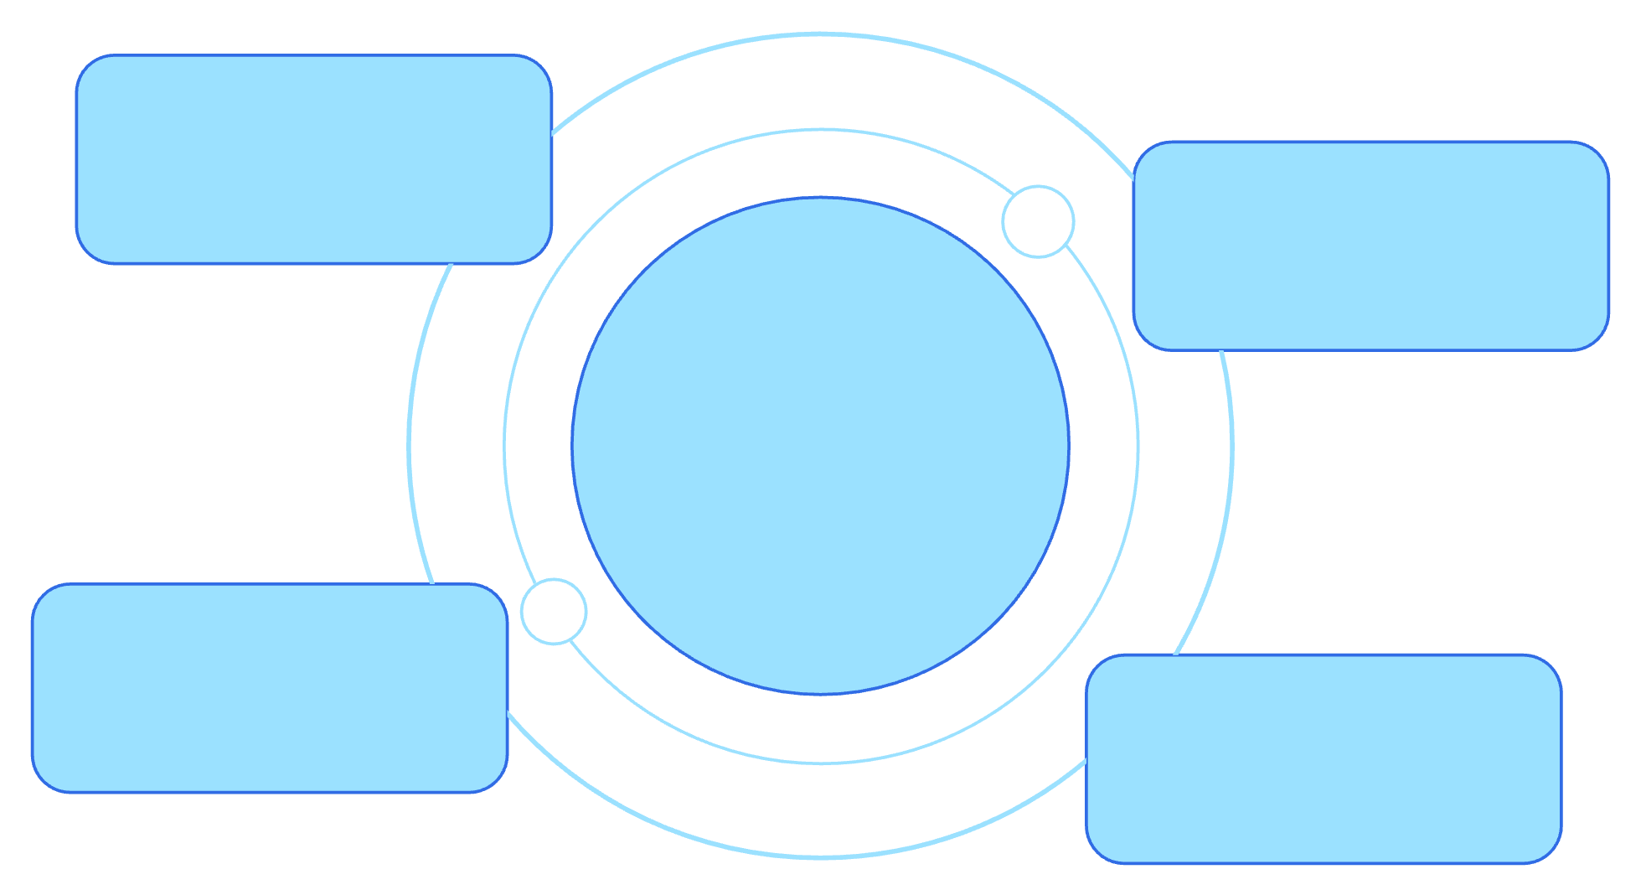
SYSTEM SHAPE
A lightweight extension with a full agent backbone
Side Panel
Task input, controls, timeline, Explain, Answer
Service Worker
Orchestration, goal parsing, lifecycle, routing
Browser Agent
SightLite agent backbone coordinating components
Content Script
DOM scanning, browser actions, overlays, interaction
Offscreen Doc
Screenshots, processing, ONNX vision inference
The user sees a focused side panel. Behind it, SightLite coordinates perception, actions, inference, sessions, and analytics.
04

Slide 5
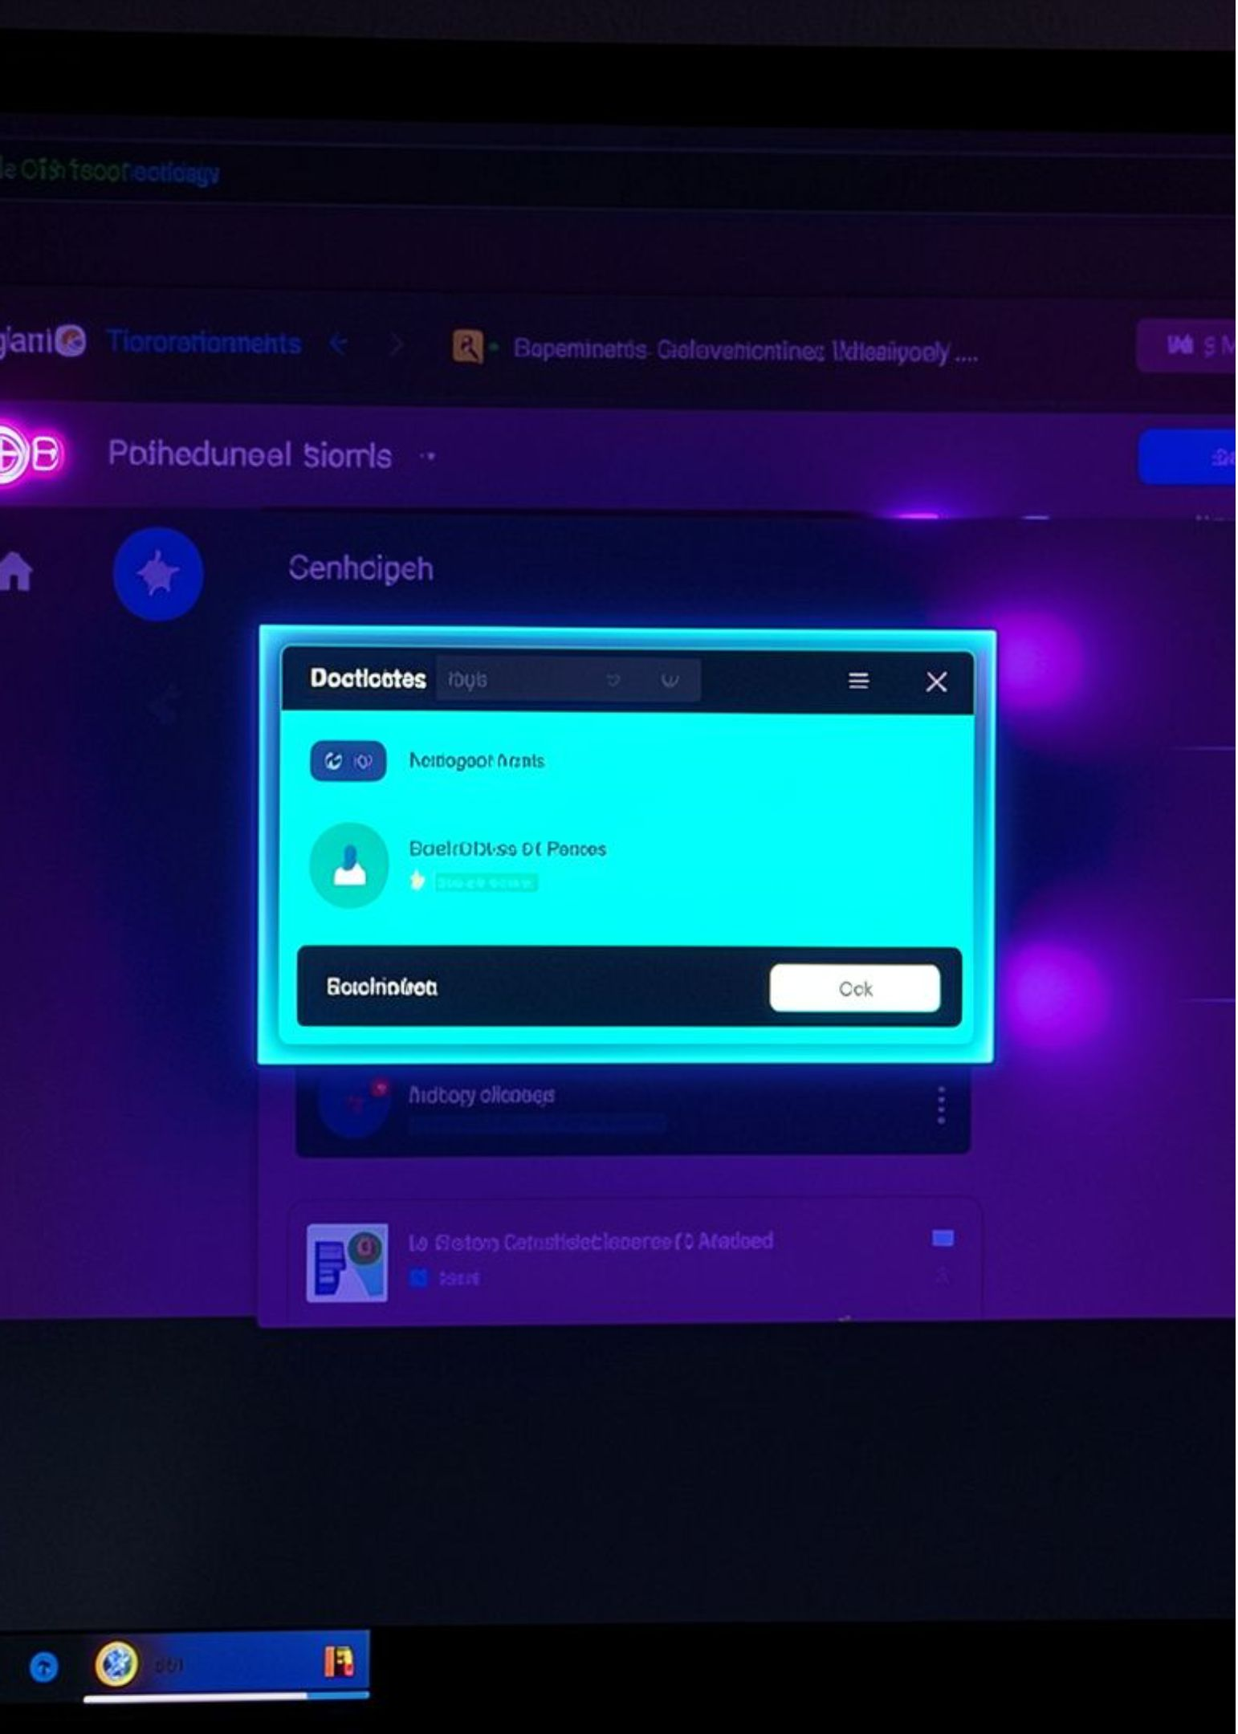
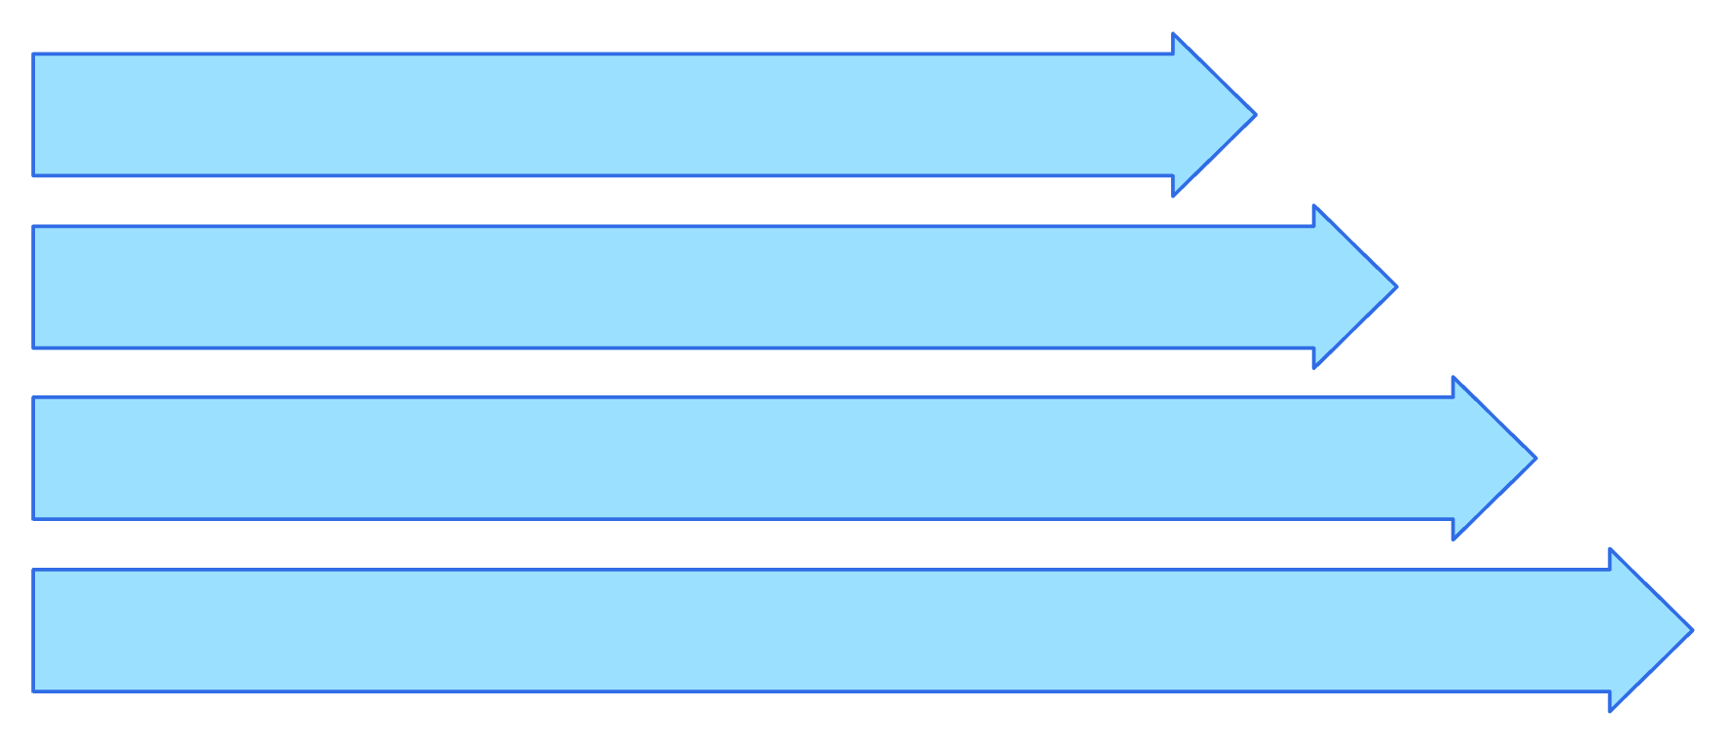
TARGET SELECTION
Target selection combines vision, DOM, and intent
Parse Intent
Perceive Page
Rank Candidates
Execute & Verify
05

Slide 6
BROWSER-NATIVE STACK
The stack is optimized for browser-native perception
Vision takes a 640 × 640 screenshot and returns bounding boxes, labels, and confidence scores before DOM fallback and element matching.
LAYER | TECHNOLOGY | ROLE
Browser | Google Chrome · Manifest V3 extension | Native browser surface
Interface | HTML · CSS · JavaScript | Side panel and interaction layer
AI vision | ONNX Runtime · uidet-nano-int8.onnx | Screenshot detection
Language | Google Gemini 1.5 Flash | Goal understanding
Platform | Python FastAPI · PostgreSQL · Docker | Sessions and analytics
06

Slide 7



ACCESSIBILITY BY DESIGN
Accessibility is built into the interaction model
CLEAR SIGNAL
KEYBOARD-FIRST
PERCEIVABLE ACTION
High-contrast interface and clear status indicators.
Keyboard navigation and screen-reader-friendly ARIA labels.
Visual target highlighting and natural-language task interaction.
07

Slide 8
PROJECT OUTPUT
END-TO-END DEMO
Key outcomes
SightLite makes the browser easier to see, control, and understand
Accessible browser control through natural language
Vision, DOM, and intent fused for reliable target selection
Verified actions with clear completion feedback
A lightweight Chrome extension with an agent backbone built for practical, browser-native assistance.
Trigger
Perception
Action
Report

Slide 9
SIGHTLITE · TEAM BLUEBIRD
Thank You
Questions and discussion
09

